Slide 1

DEVELOPMENT OF STOCK TRADING
WEBSITE
By,
Purple Team

Slide 2

Team Details
Shireesha Budumuru[Lead]
Yamuna Venkatesh
Sai Chaithanya Sadhula

Slide 3

CONTENTS
Web Application and Development
Front -End Deployment
Back-End Deployment
Project creation
Result and Conclusion
References

Slide 4
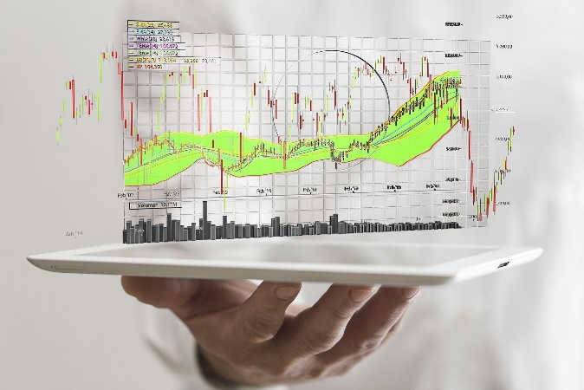
PROBLEM STATEMENT
Due to the emerging sales , stock market is growing rapidly in today’s scene.
Prediction of stocks , maintenance of sales information makes to develop
and increase the potential of the trade
In order to achieve this, we have created a simple stock trading platform
which helps in buying and maintaining of stocks

Slide 5

What is Web Application and its development?
A Web app is an application program that is stored on a remote server and
delivered over the Internet through a browser interface.
A web app requires mainly three elements to function properly.
This includes :
A web server to handle requests from the client
An application server to execute the tasks requested
And a database to store the information
Benefits Web applications :
Web applications offer a higher level of data security, as the data is stored
on remote dedicated web servers.
Example of web application includes an instant messaging app like WeChat,
a social media platform like Whatsapp, a shopping site like Flipkart etc.
In the below slides we have shown the deployment of a simple stock market
trading website.
Web development mainly divided into : Front-End and Back-End development

Slide 6
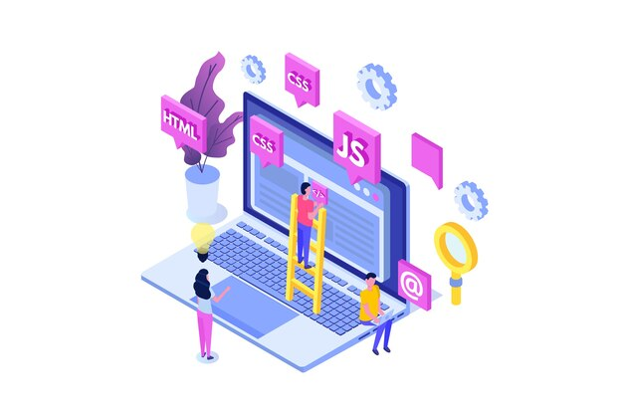
Front-End Development
Front-End is the part of web development that codes and creates front end elements of a website,
which are features that are directly viewable and accessible by the end-user or client.
A front end developer is responsible for everything you see and works to enhance the user experience
to ensure it is seamless.
They help create the overall design and aesthetic, in addition to debugging and using static code
analysis.
Front end developers are responsible for implementing visual components on a website as well as
interactive features like navigation, buttons, or anything that enhances overall usability.
HTML, JavaScript, and CSS are often used to make sure the visual side (or client-side) of a site runs
smoothly so that users can interact freely and comfortably with it.
Technologies used
HTML , CSS, Bootstrap and JavaScript

Slide 7
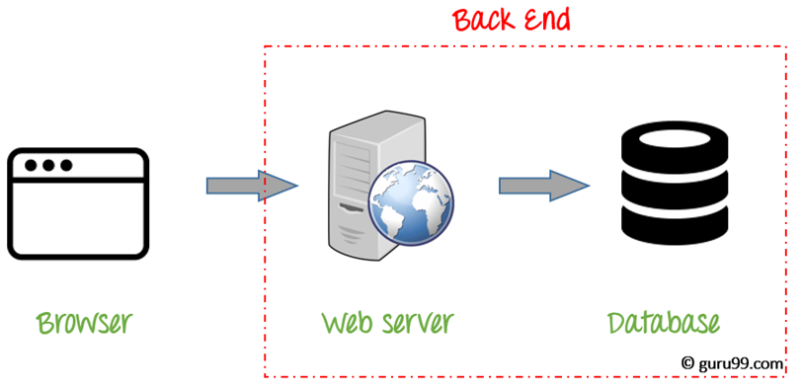
Back-End Development
Mainly referred as the server-side development.
It contains behind-the-scene activities that occur when performing any action on a website.
It can be an account login or making a purchase from an online store.
Code written by back-end developers helps browsers to communicate with database information.
This is in contrast to “client-side” code, which runs in users web browsers and is written mostly by
front-end developers.
Back-end developers build, maintain, and debug the back end that runs an application.
Main task of back-end development includes:
Creating, integrating, and managing databases.
Using back-end frameworks to build server-side software.
Validating data to make sure it's formatted correctly before being sent to the database.
Technologies used
MySQL , Java , Server, Core Java

Slide 8
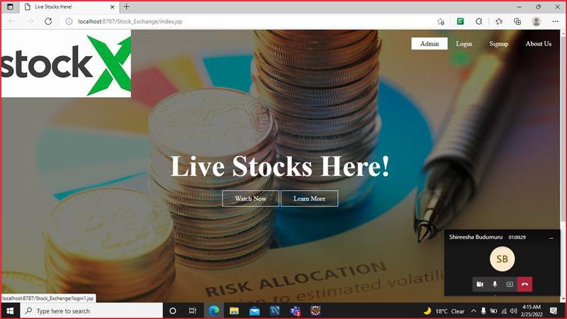
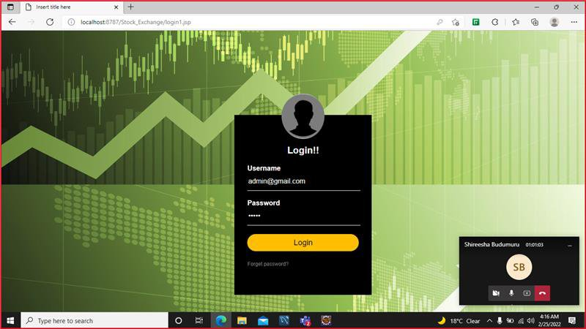
Project Implementation

Slide 9
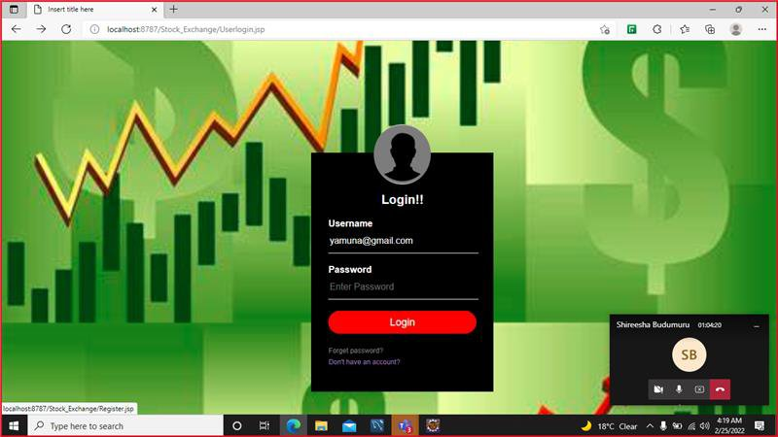
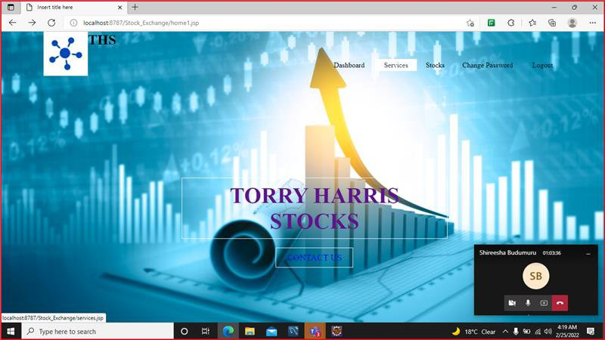

Slide 10
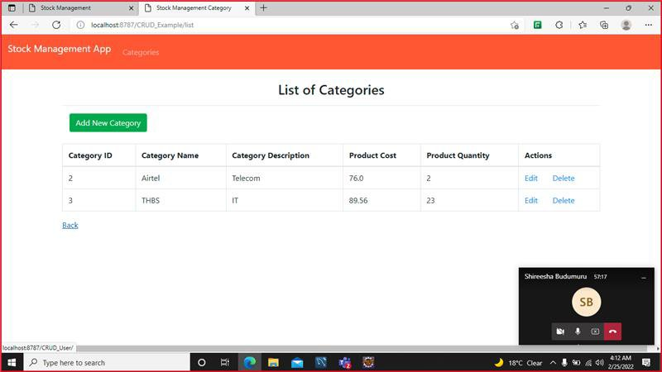

Slide 11
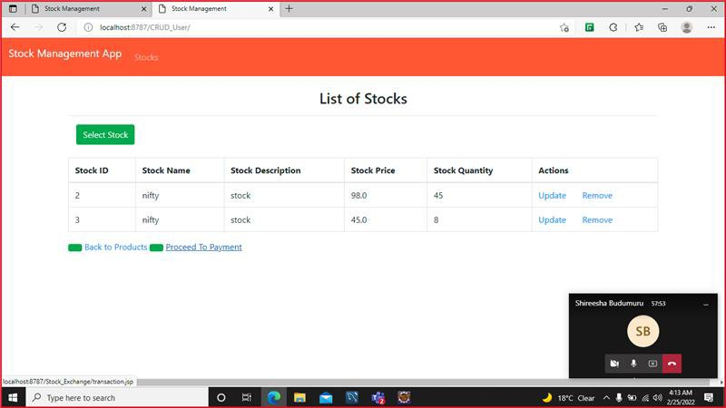

Slide 12
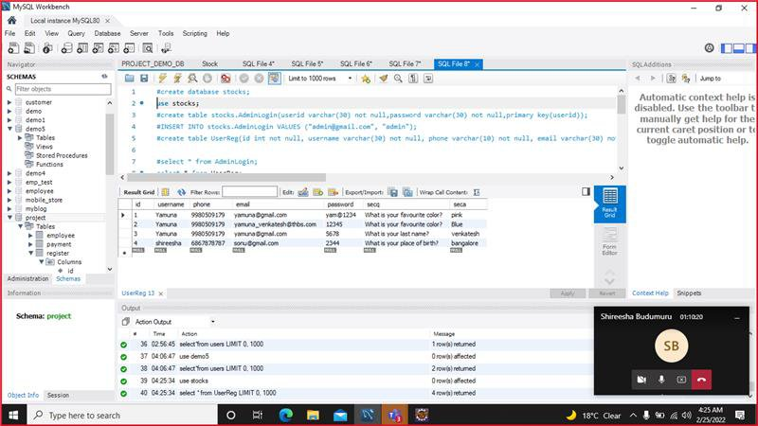

Slide 13
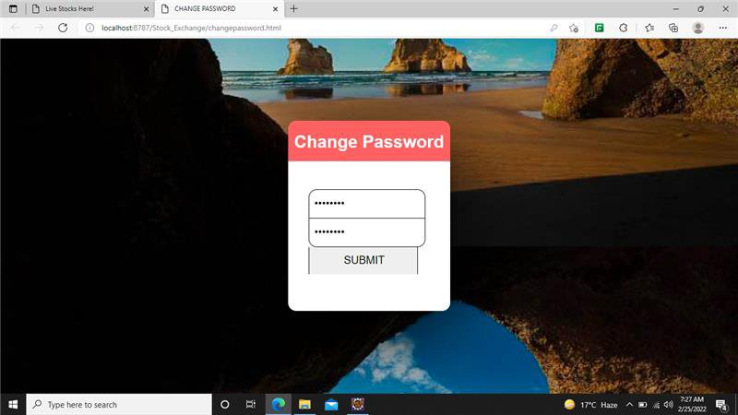
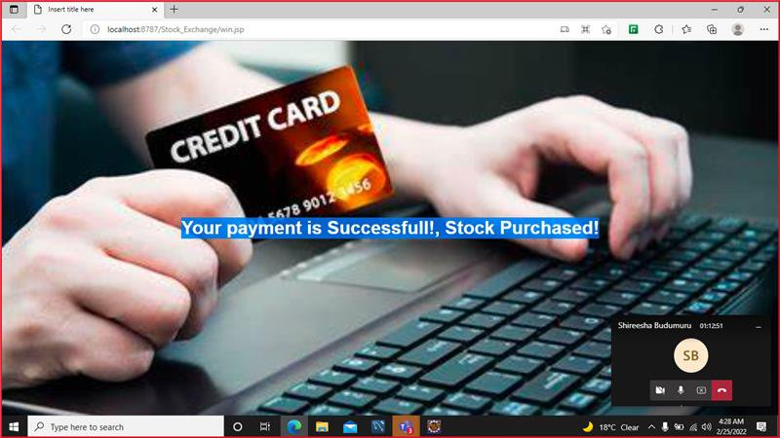

Slide 14
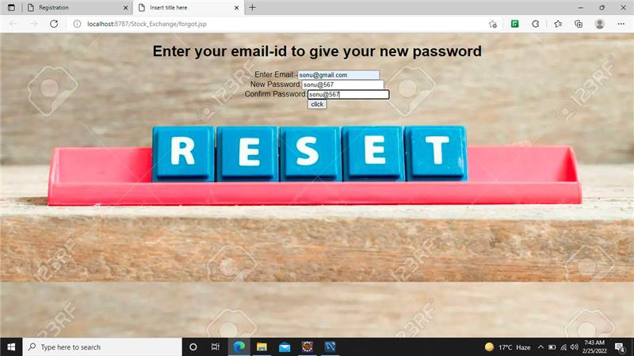

Slide 15
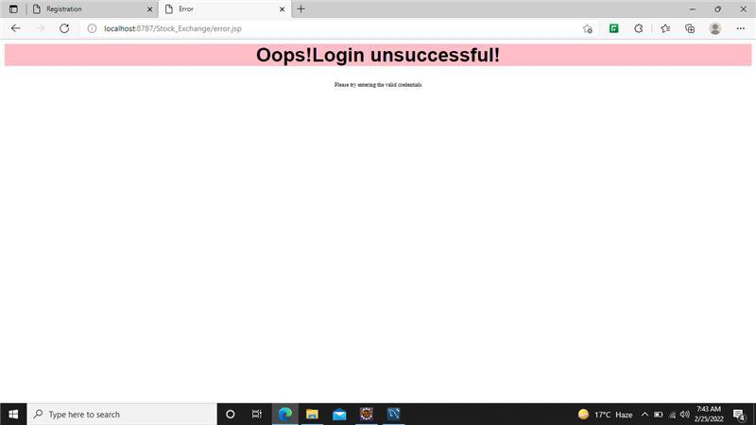

Slide 16
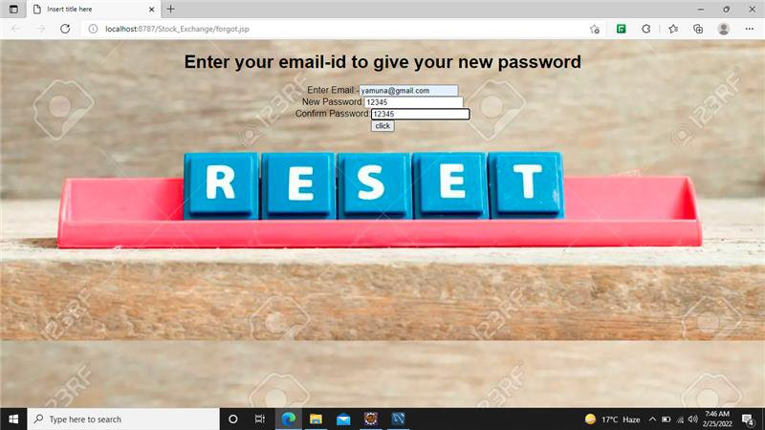

Slide 17
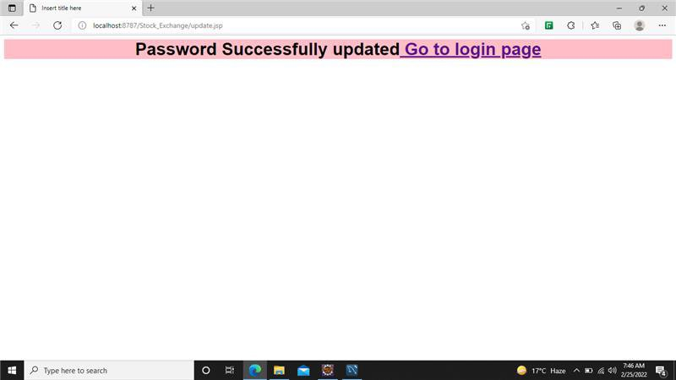

Slide 18
Conclusion
Connected the front-end pages with the back-end code and established
connection between them.
Finally we have created a simple trading platform , where stocks can be
purchased and maintained.

Slide 19
References:
As a conclusion, we can say special thanks to our trainer Girish sir for training
us in all the aspects.
A special thanks to THBS management and Alchemy Solutions.

Slide 20
Thank You
-Purple Team…

